Slide 2
This year:
Military unit
1 wrong = all wrong
-10%
Little teacher
Pay attention
Sit up
cards

Slide 3
a
an
the

Slide 4
當談論所有發言者都知道的特定事物時使用“the”。
例子：”Let’s go to the store tomorrow.” “明天我們去商店吧。”
聽起來我想去一家特定的商店，而與我交談的人都知道我在談論哪家商店。
談論一般性事物時使用 a/an
例子：”Let’s go to a store tomorrow.” “明天我們去商店吧”
這是一般情況－哪家商店並不重要

Slide 5
What do you do?
你做什麼？
你做什麼工作？

Slide 6
What
do
you
do
?
I
V 動詞
.

Slide 7
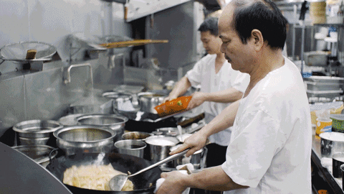
What do you do?
I cook.
I V 動詞.

Slide 8
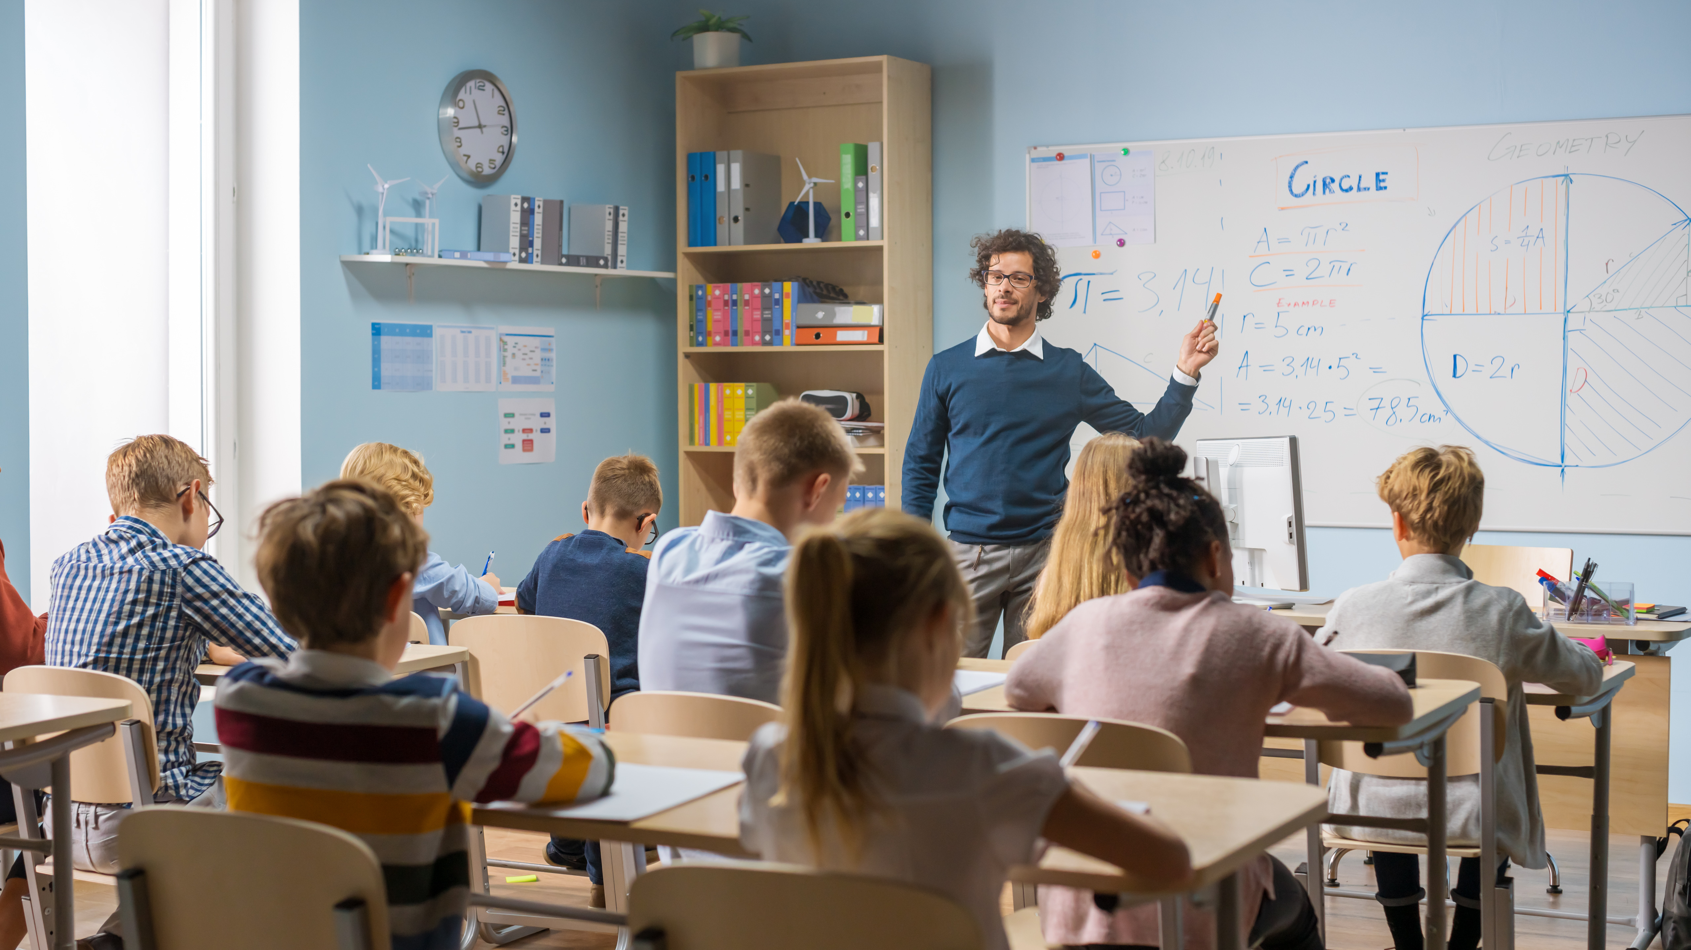
What do you do?

Slide 9
I teach.

Slide 10
What do you do?

Slide 11
I am a teacher.

Slide 12
What
are
you
?
a
an
the
I
am
什麼
.

Slide 13
What are you?
你是什麼？
你做什麼工作？

Slide 14
What are you?

Slide 15
I am a man.

Slide 16
I am a teacher.

Slide 17
What is your job?
工作；職業；零工

Slide 18
I am a teacher.

Slide 19
What do you do?

Slide 20
I study.

Slide 21
What are you?

Slide 22
I am a student.

Slide 23
What
are
you
doing
?
I
am
V 動詞 + ing.

Slide 24
What are you doing?
你在做什麼？

Slide 25
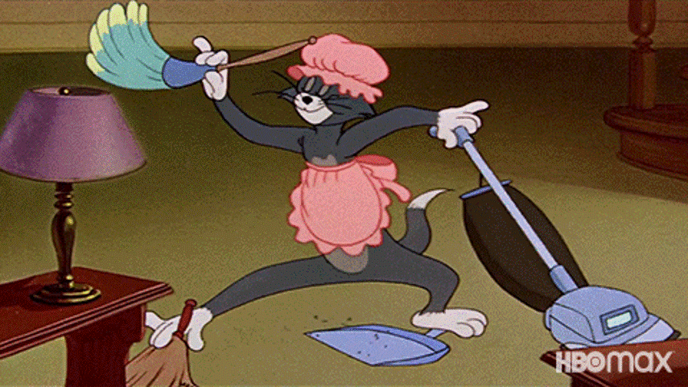
What are you doing?
I am cleaning.

Slide 27
V. 動詞
+
er
=
做這個 V. 動詞的人
愛做這個 V. 動詞的人
做這個 V. 動詞的機器
做這個 V. 動詞的…

Slide 28
EA
有時候
EE
總是

Slide 29
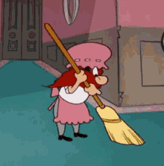
SW
EE
P
v. 動詞

Slide 30
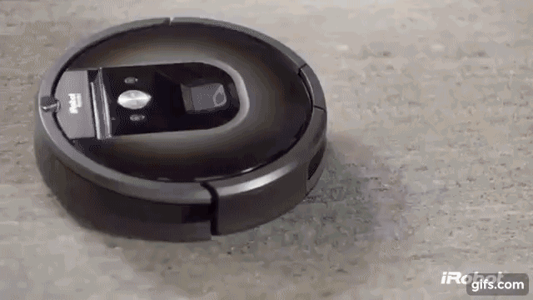
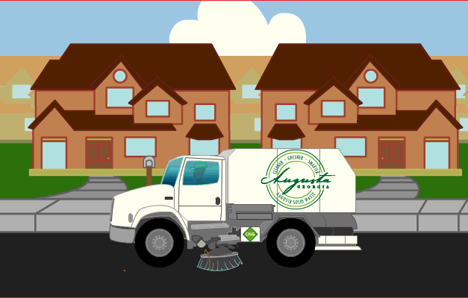
SW
EE
PER
n. 名詞

Slide 31
What do you do?
你做什麼？
你做什麼工作？

Slide 32
I sweep.

Slide 33
What are you doing?
你在做什麼？

Slide 34
I am sweeping.

Slide 35
What are you?
你是做什麼的？

Slide 36
I am a sweeper.

Slide 38
M
O
P
v. 動詞

Slide 39
MOP
PER
n. 名詞

Slide 40
What do you do?
你做什麼？
你做什麼工作？

Slide 41

I mop.

Slide 42
What are you doing?
你在做什麼？

Slide 43
I am mopping.

Slide 44
What are you?
你是做什麼的？

Slide 45
I am a mopper.

Slide 47
C
L
EA
N
v. 動詞

Slide 48
What do you do?
你做什麼？
你做什麼工作？

Slide 49
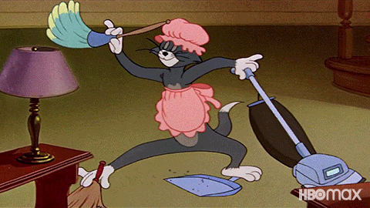
I clean.

Slide 50
What do you clean?

Slide 51
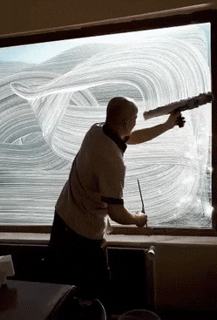
I clean windows.

Slide 52
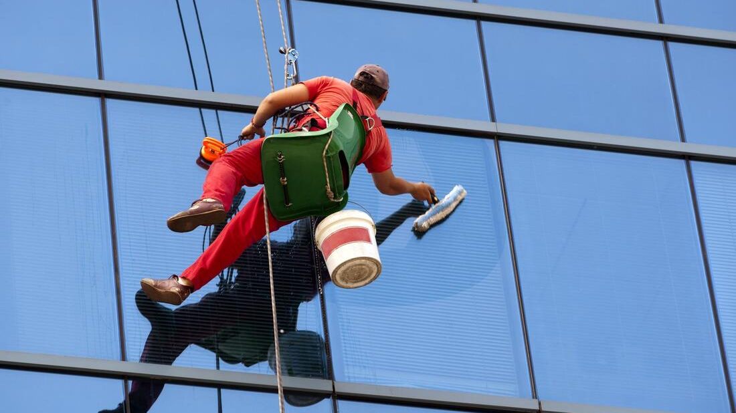
What is he doing?

Slide 53
He is cleaning windows.

Slide 54
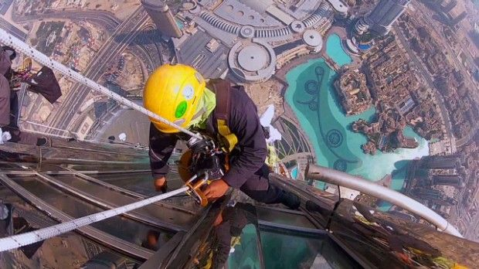
What is his job?

Slide 55
He is a window cleaner.

Slide 56
What do you clean?

Slide 57
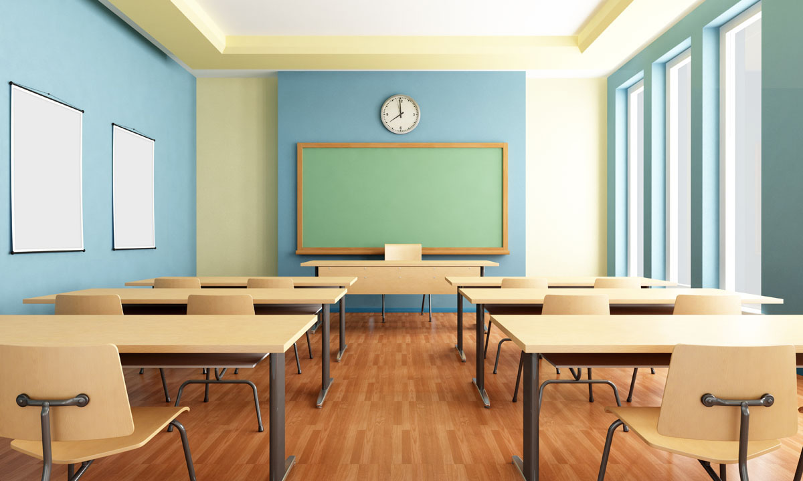
I clean my/the classroom.

Slide 58
I clean my/the table.

Slide 59
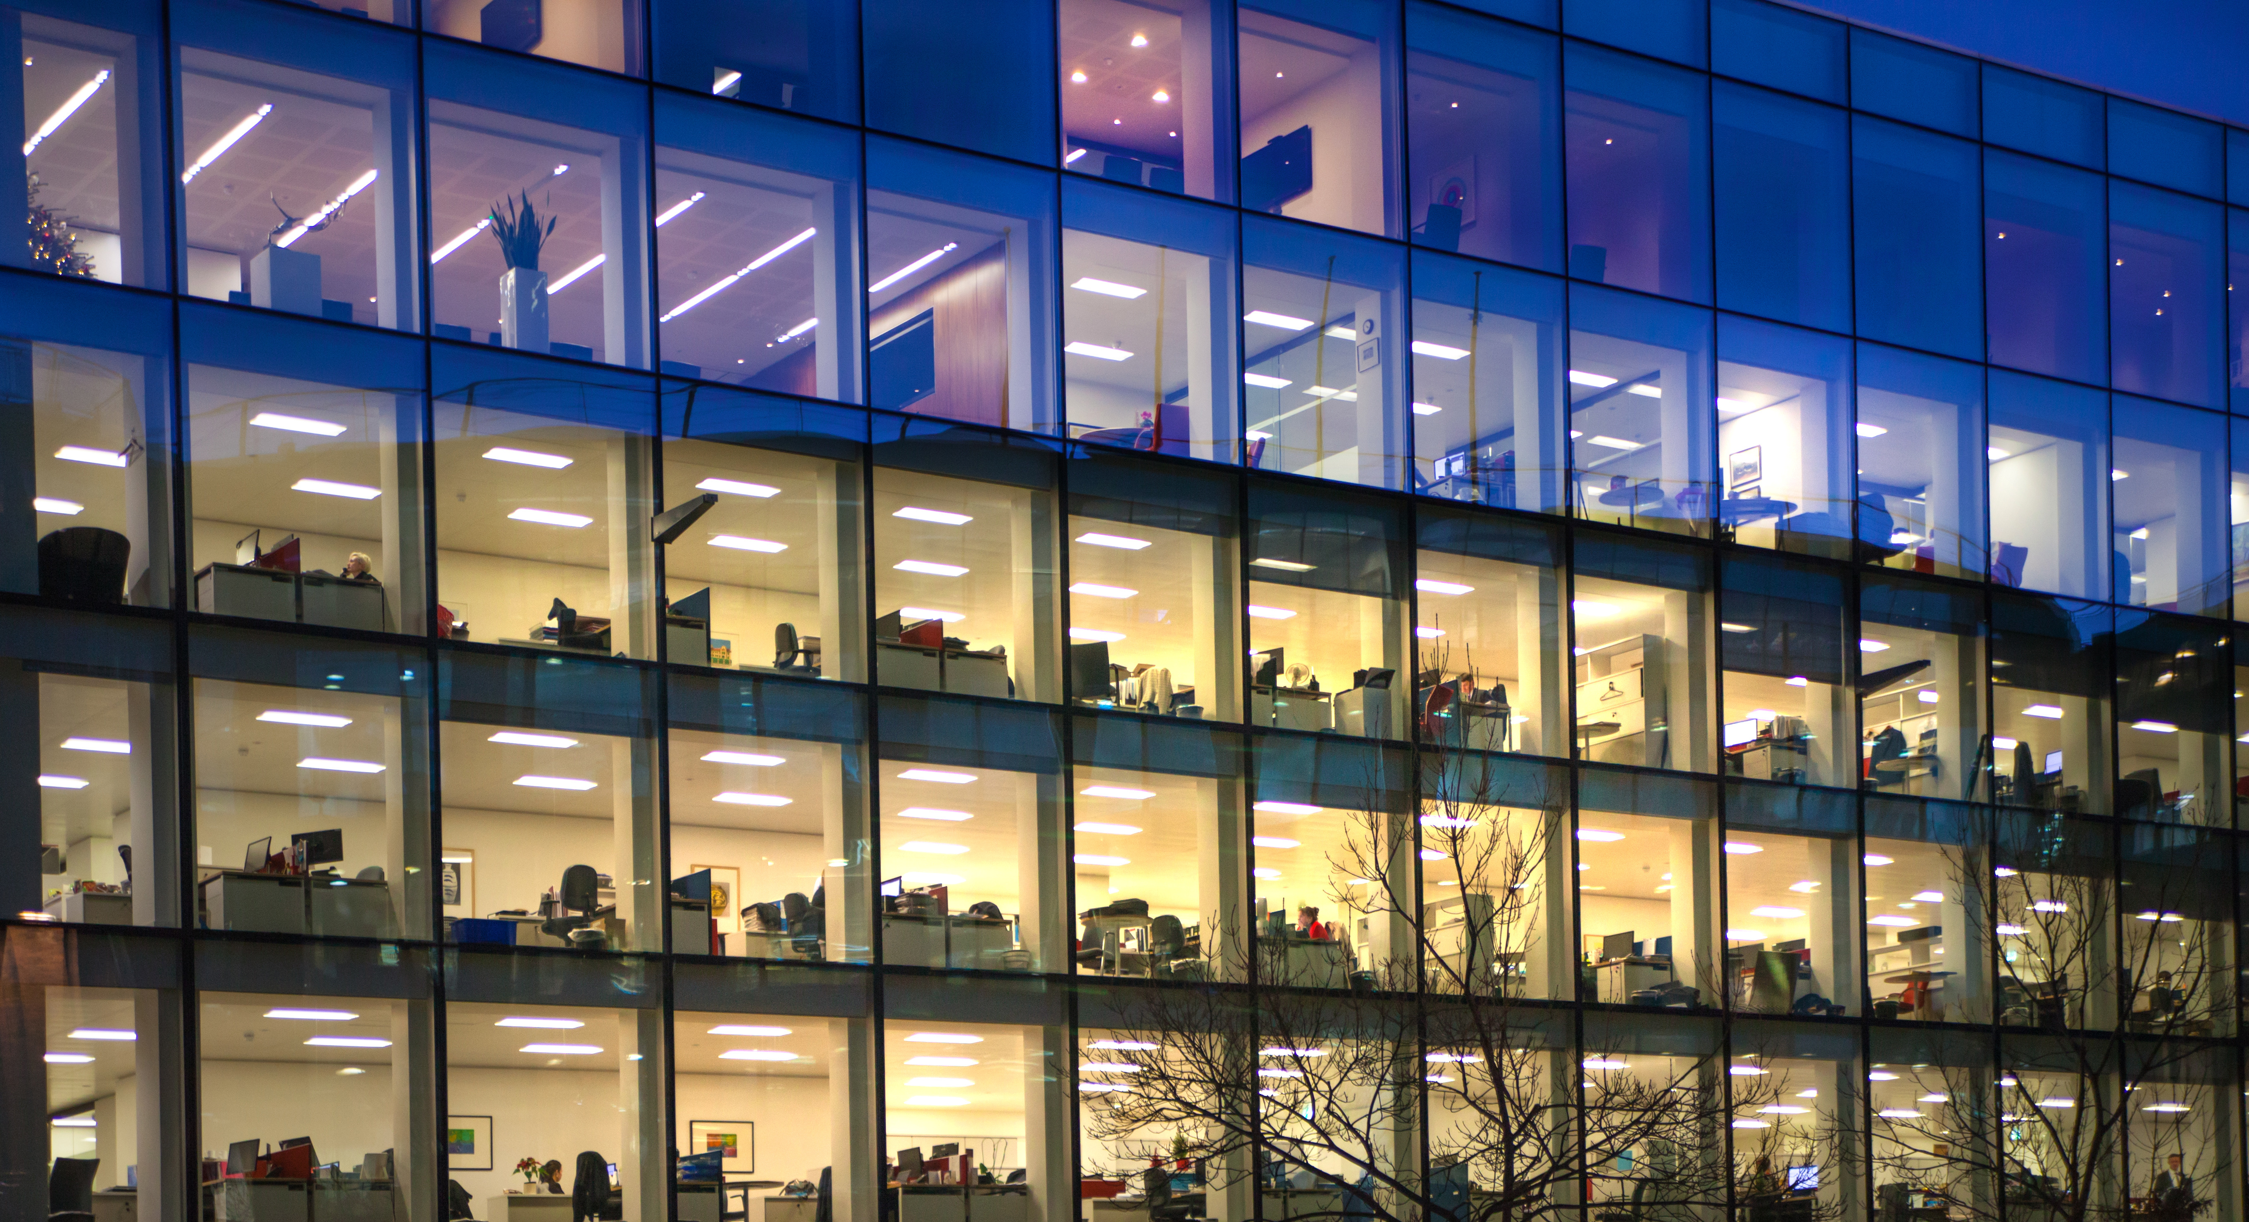
I clean tables.

Slide 60
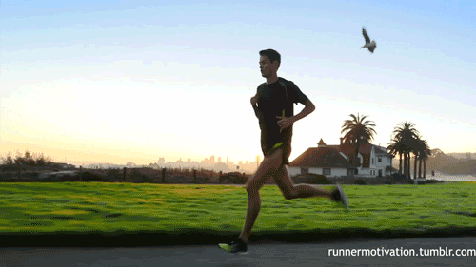

Slide 61
